Slide 1
LBI – Forest Health, Selkirk District
Dean Christianson, Stewardship Forester

Slide 2
FY13 Accomplishments
Budget was $584,166, spent most of it
Detailed IBM Flight in all or portions of 3 BMUs in Kootenay Lake, 5 BMUs in Boundary, 3? BMUs in Golden under contract
Kootenay Lake IBM surveys and fall & Burn
  Very low infestation rate found from flight and on ground.
  154 Star probes
  273 trees felled and burned
Boundary IBM surveys and Fall & Burn
  Much higher green attack levels, treatment in West Grand Forks Unit around Phoenix area and in SE portion of Main Kettle BMU (treated previous year as well)
  Insufficient harvesting support and unable to treat entire suppression unit with funds – areas no longer classified as Suppression
  445 Star probes
  2137 trees felled and burned

Slide 3
FY13 Accomplishments Cont’d
Detailed IBD flight in Arrow, Boundary & Kootenay Lake suppression units by staff
IBD Ground Surveys under contract in Arrow & Kootenay Lake
  26.4 km of ground surveys, very low green attack found

Slide 4
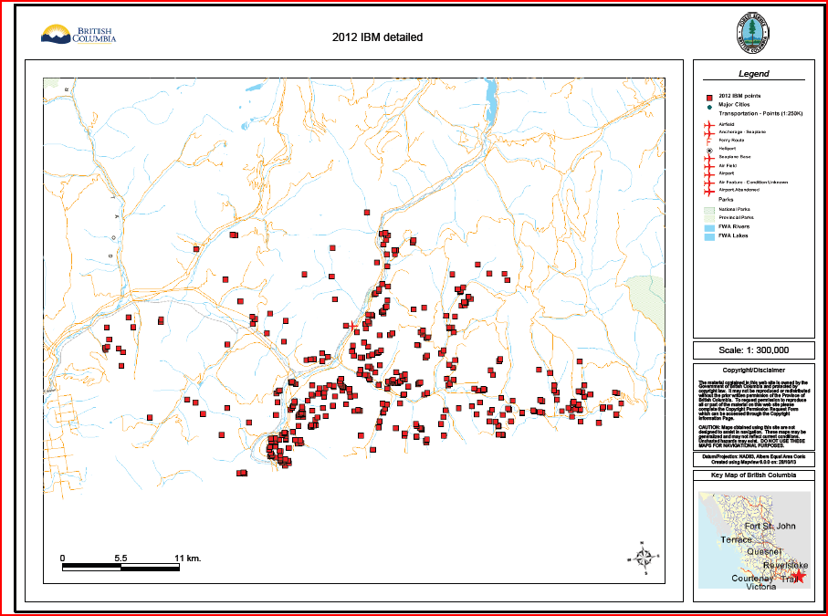

Slide 5
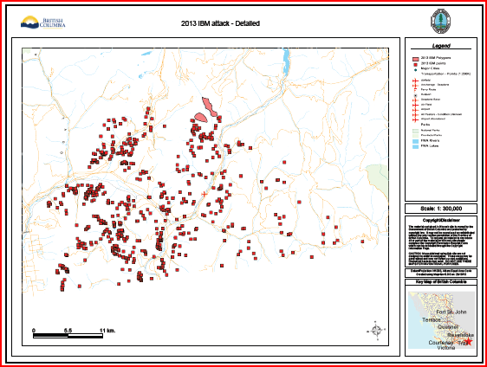

Slide 6
F14 Plans and accomplishments
Budget was $37,000 – spent on detailed flights
IBM detailed flight for all of Kootenay Lake 3 BMUs (Yahk Area) completed
  Higher red #s noted this year
  Currently $54K of surplus to spend in Yahk area surveying and F&B on IBM
  Insufficient funds to survey & treat all nodes identified, targeting easiest access points with Hawkins BMU as 1st priority
  May be more surplus $s coming, no guarantee
IBD flight for portions of Kootenay Lake and most of Arrow TSA suppression units completed
  Data not compiled yet, looks similar to last year in general, hot spots – Pend D’Oreille, Hills, North end of Kootenay Lake
  Insufficient funds to complete all suppression BMUs in the 3 TSAs

Slide 7
2013 Overview Flight Trends
Balsam Bark Beetle
  Arrow -Down slightly
  Boundary -Up
  Kootenay Lake -Down
  Golden -Up
  Revelstoke -Up
Spruce Bark Beetle
  - Not on radar!

Slide 8
2013 Overview Flight Trends cont’d
Douglas-fir Bark Beetle
  Arrow -Up
  Boundary -Up
  Kootenay Lake -Up
  Golden -Up slightly
  Revelstoke -Up

Slide 9
2013 Overview Flight Trends cont’d
Mountain Pine Beetle - Pli
  Arrow -Down
  Boundary -Up
  Kootenay Lake -Down
  Golden -Stable
  Revelstoke -Stable

Slide 10
FY15 Budget
IBD/IBS & IBM detailed surveys and IBM Fall & Burn - $746,000 requested

Slide 11
Actions required
Require additional immediate action harvesting support, ideally on smaller units to reduce losses, LBI costs and hopefully reduce IBM levels.
Recommend Licencees monitor harvest units for post harvest blowdown and salvage or trap tree as necessary to minimize and / or reduce future IBD losses

